Slide 1
Adv. Java Training Presentation
Session 2019 -2020
Newsprism
Training From:
Grass Solution Pvt. Ltd.
Submitted By:
Naresh Mali (Team Leader)
Ashish Jain
Harshit Paneri

Slide 2

Welcome to Techno India NJR Institute of Technology, Udaipur
“Education educates a man, but good education creates a man” is the belief of NJR Foundation which established Techno India NJR Institute of Technology in the year 2008.
NJR Foundation, a registered trust, was established in the year 2003 in memory of Shri Navdeep Ranawat and Shri Jitendra Ranawat by Mrs. Meera Ranawat and Mr. Raj Shekhar Vyas, an alumnus of BITS, Pilani having more than 25 years of experience with Tata group and as Techno entrepreneur. Nine more highly qualified trustees with vast experience in the field of law, administration, finance research papers writing and business were inducted subsequently.
Techno NJR was set up with a vision of providing international level engineering education to students of Udaipur so that they do not have to travel to Bangalore, Pane, Jaipur for good engineering education.

Slide 3

Grras Solution Pvt. Ltd.
GRRAS Solutions specializes in the domain of Red Hat Linux training, AWS Cloud Computing, Digital Marketing, Python, Website Design & Development, Bigdata haddop for In-house training, Industrial/Internship training, Online Learning and Corporate Training. Being an authorized and renowned partner of Red Hat since 2008, from last 12 years we hold special badge of honor for providing excellent business and learning facility across India. We also have our own Pearson VUE examination center, Red hat Authorized Centre & Kryterion Authorized Testing Center.

Slide 4

Technologies
Web Design- Prepare for a career as a professional website designer crafting the look, layout, and organization of websites. The applications and concepts for this emphasis include HTML, Dynamic html, Photoshop, CSS, jquery, flash, Dreamweaver, style sheets, information architecture and graphical design concepts.
Web Development- The applications and technologies for this emphasis include web design techniques and also development programming tools like Bootstrap, Node.js, Angular Js, MongoDB, Express.js, Crystal report, domain registration, web hosting and many other web development tools.

Slide 5

Why Choose Grras
GRRAS provides proven training content through a combination of delivery model and vivid customer experience. Spread across 12 cities across the nation, our company has assisted over Six thousand working professionals in kick starting their career.

Slide 6
Node.js
Node.js is a server-side platform built on Google Chrome's JavaScript Engine (V8 Engine). Node.js was developed by Ryan Dahl in 2009 and its latest version is v0.10.36 Node.js is an open source, cross-platform runtime environment for developing server-side and networking applications. Node.js applications are written in JavaScript, and can be run within the Node.js runtime on OS X, Microsoft Windows, and Linux. Node.js also provides a rich library of various JavaScript modules which simplifies the development of web applications using Node.js to a great extent.

Slide 7
AngularJs
AngularJs is a very powerful JavaScript Framework. It is used in Single Page Application (SPA) projects. It extends HTML DOM with additional attributes and makes it more responsive to user actions. AngularJs is open source, completely free, and used by thousands of developers around the world. It is licensed under the Apache license version 2.0.

Slide 8
Express.js
Express is a minimal and flexible Node.js web application framework that provides a robust set of features to develop web and mobile applications. It facilitates the rapid development of Node based Web applications
MongoDB
MongoDB is an open-source document database and leading No SQL database. MongoDB is written in C++. This tutorial will give you great understanding on MongoDB concepts needed to create and deploy a highly scalable and performance-oriented database.

Slide 9
Front-End & Back-End Tool
Front-End Tool:-
Visual Studio Code - In which toy can build, develop, create and debug your applications is called Front-End tool.
Back-End Tool:-
MongoDB Cluster - It is a powerful relational database management system that offer a large feature set.

Slide 10
Hardware and Software Requirements
At Developer End:
Processor | Intel Core i3(Similar or Above)
RAM | 4 GB or Above
Memory | 240 GB or More
OS | Windows 7 or Above, Linux or any other
At User End:
Processor | Intel Pentium (Similar or Above)
RAM | 256 MB or more
OS | Windows XP or Above, Linux or any other
Browser | Any latest web enabled browser

Slide 11
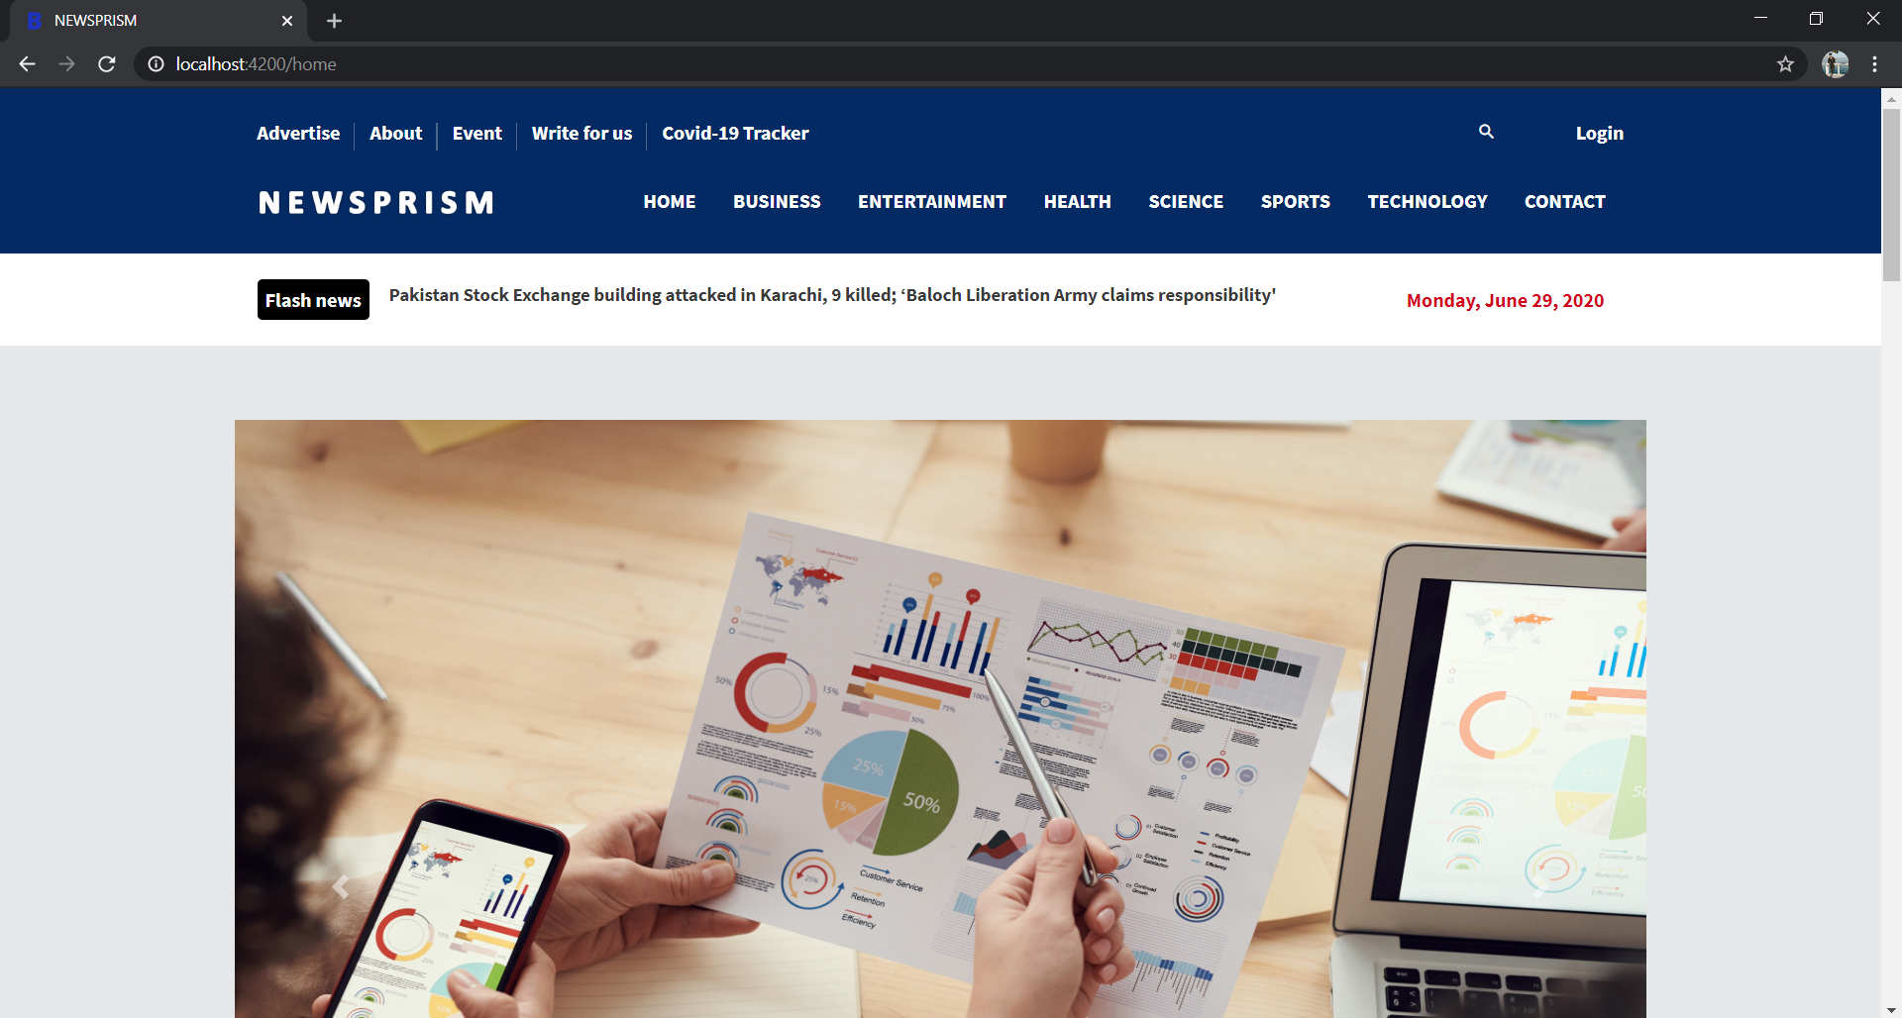
Home Page

Slide 12
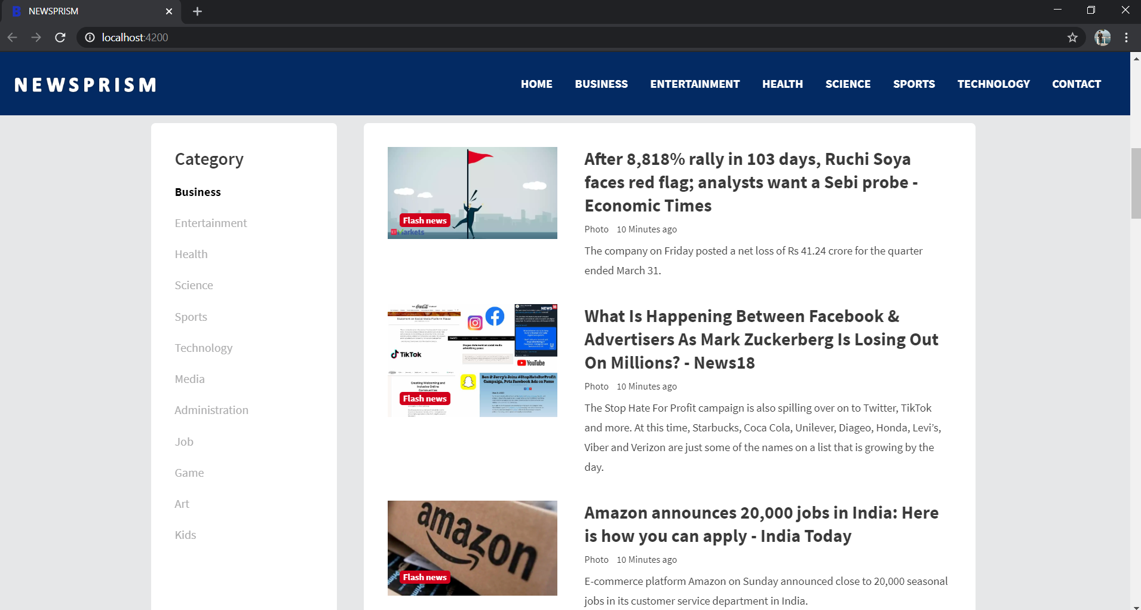
User Specification

Slide 13
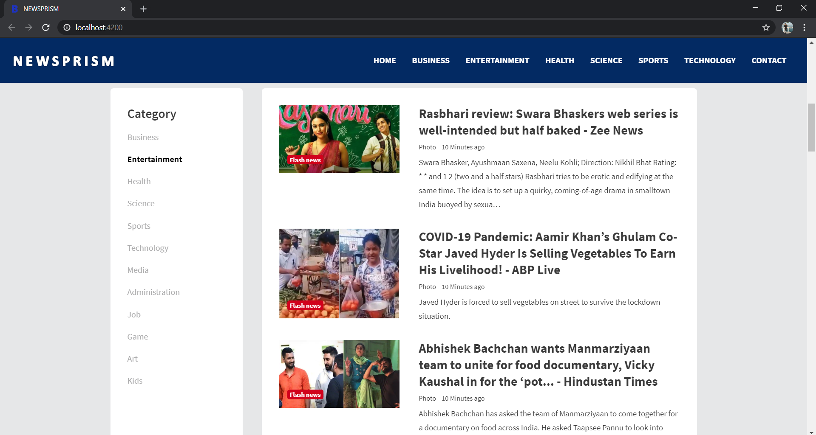
Entertainment News

Slide 14
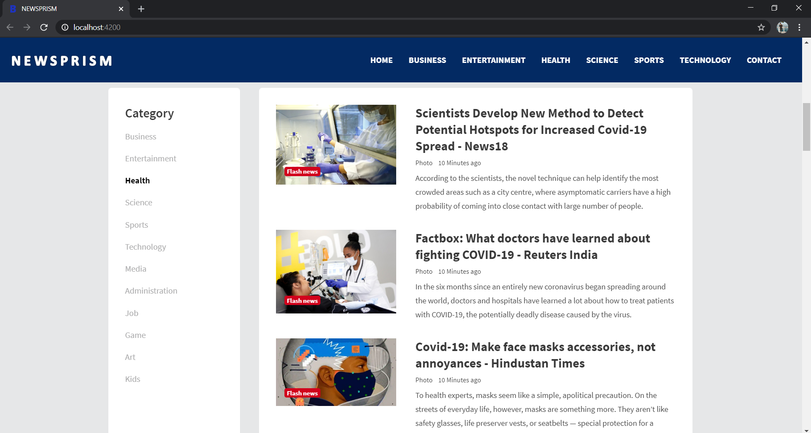
Health News

Slide 15
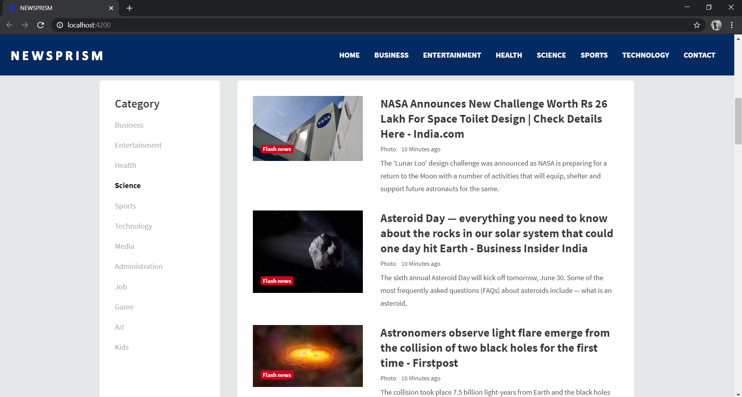
Science News

Slide 16
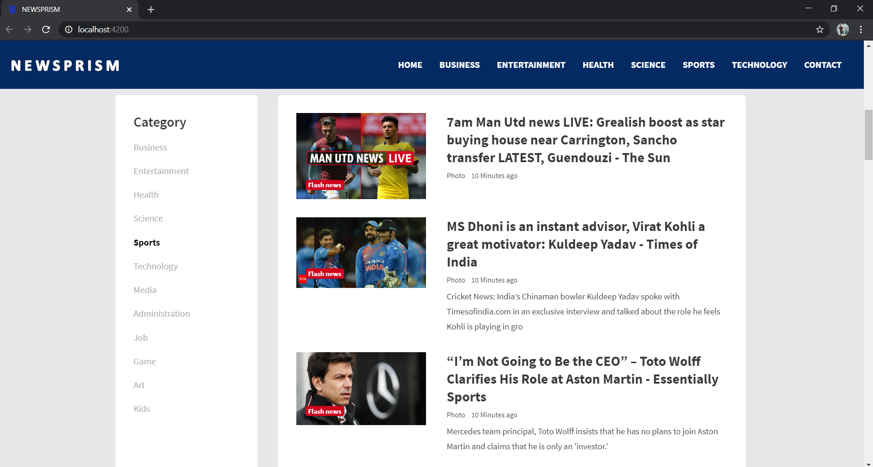
Sports News

Slide 17
Technology News

Slide 18
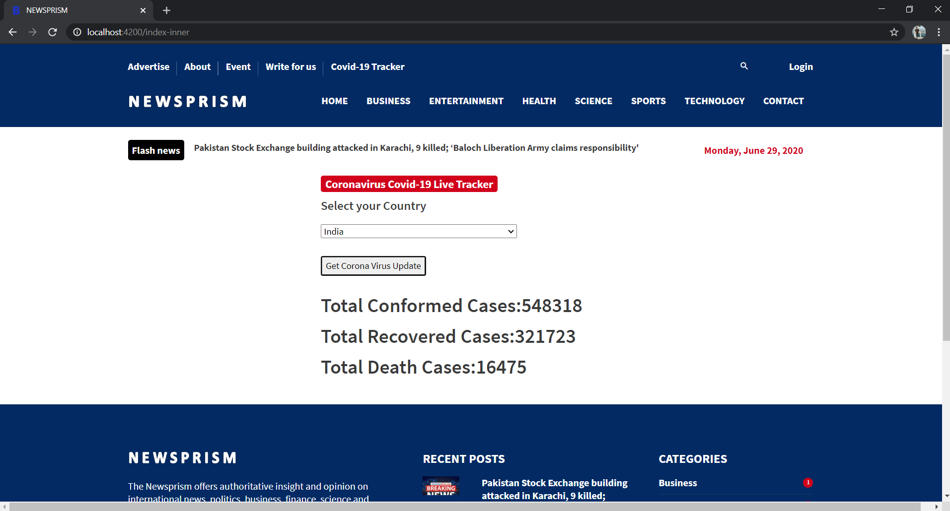
Covid – 19 Tracker

Slide 19
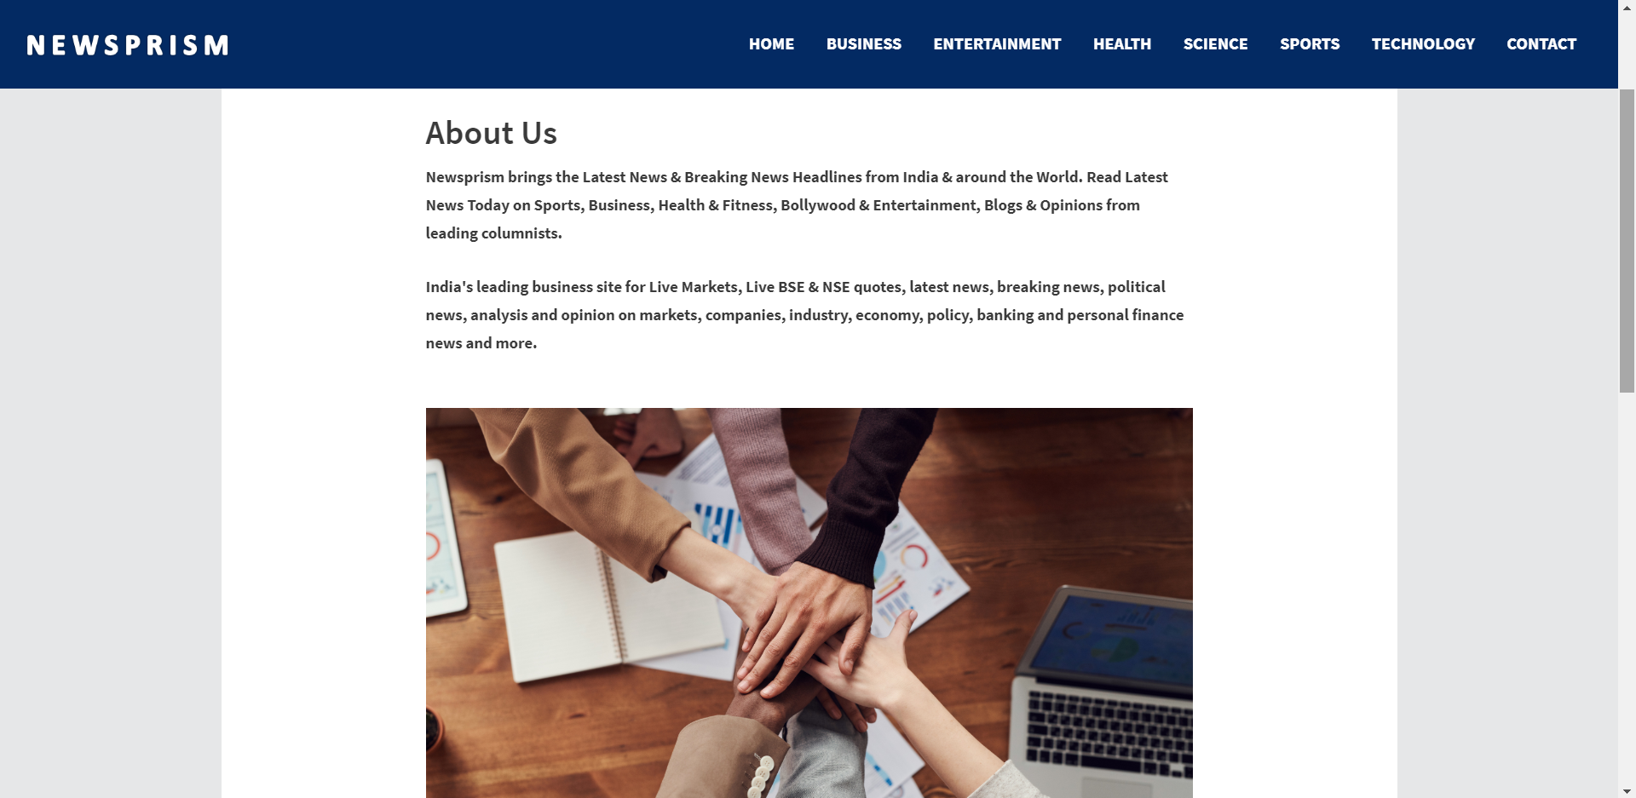
About Us

Slide 20
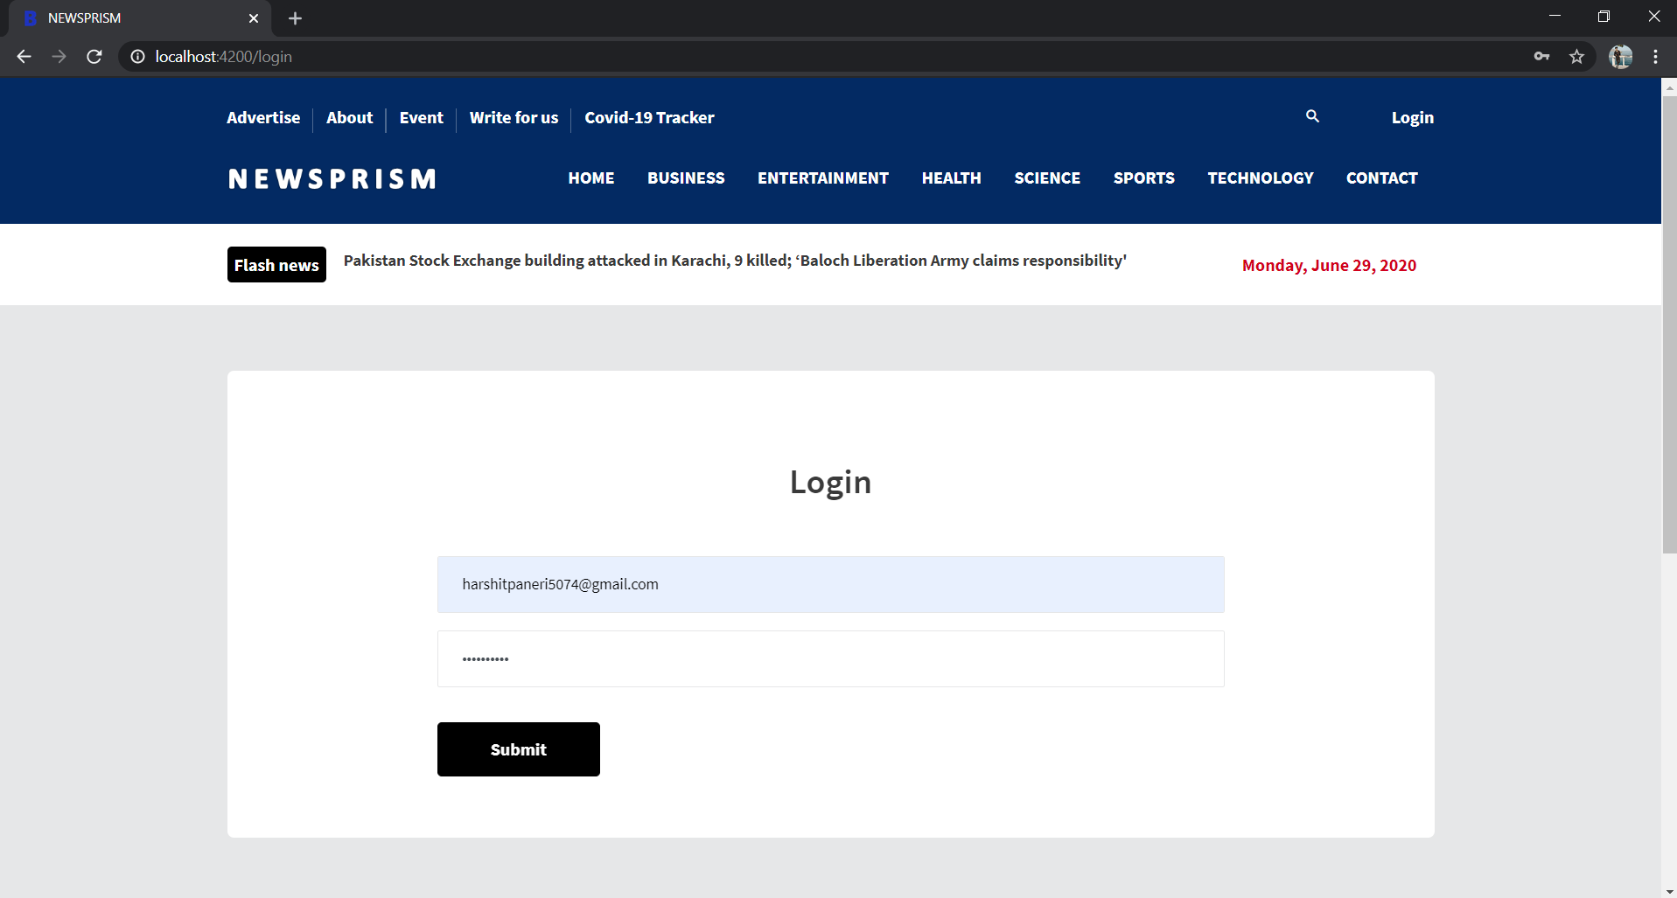
Login Page

Slide 21
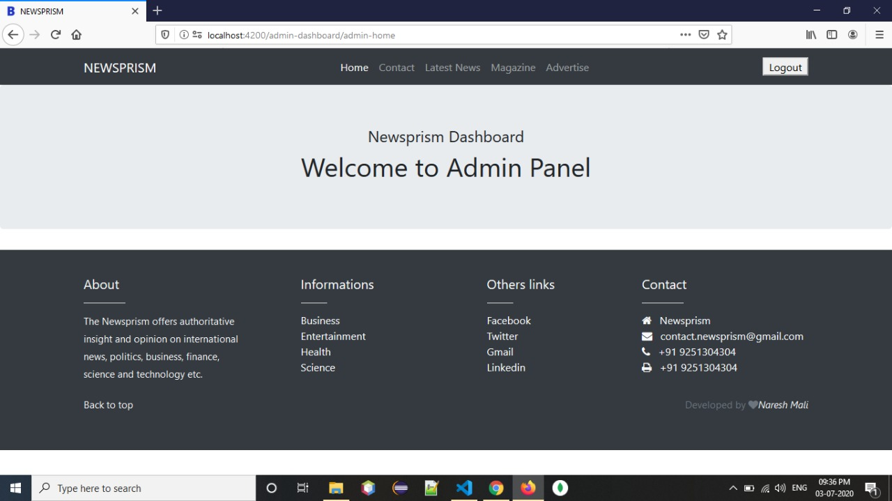
Admin Panel

Slide 22
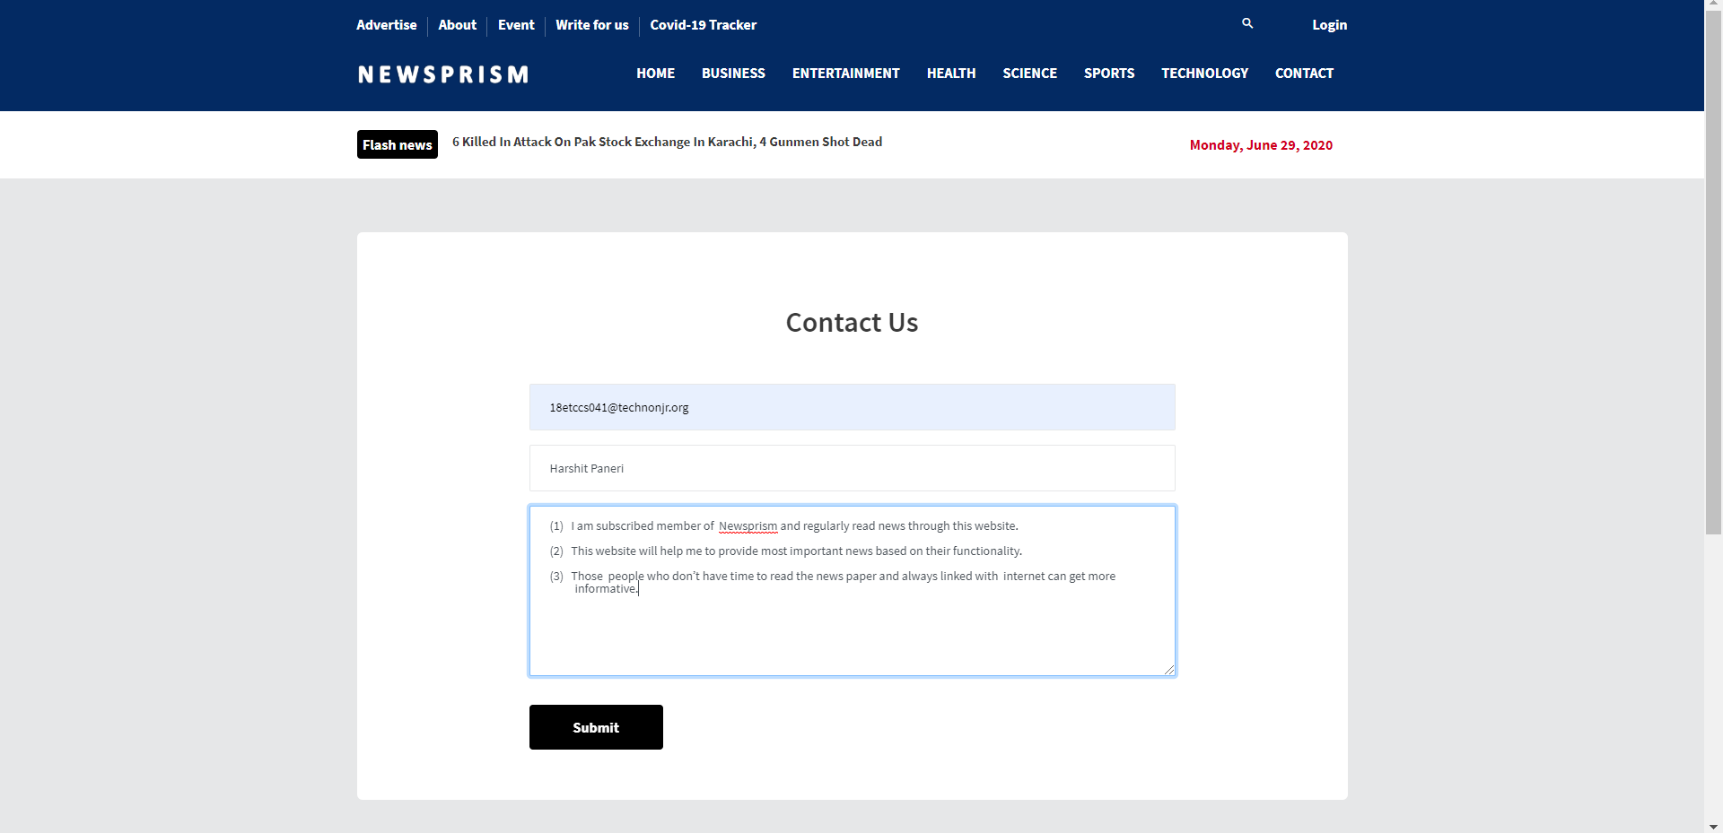
Contact Us Page

Slide 23
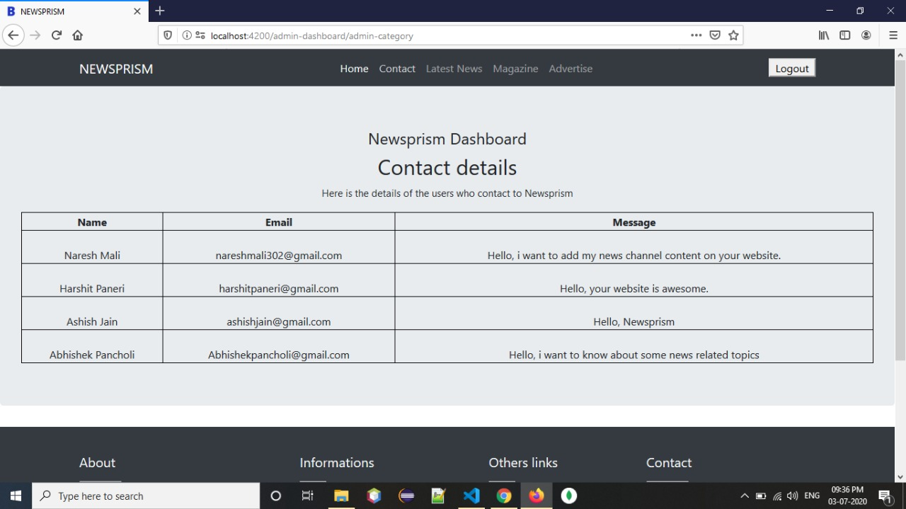
Contact Details

Slide 24


